Slide 1
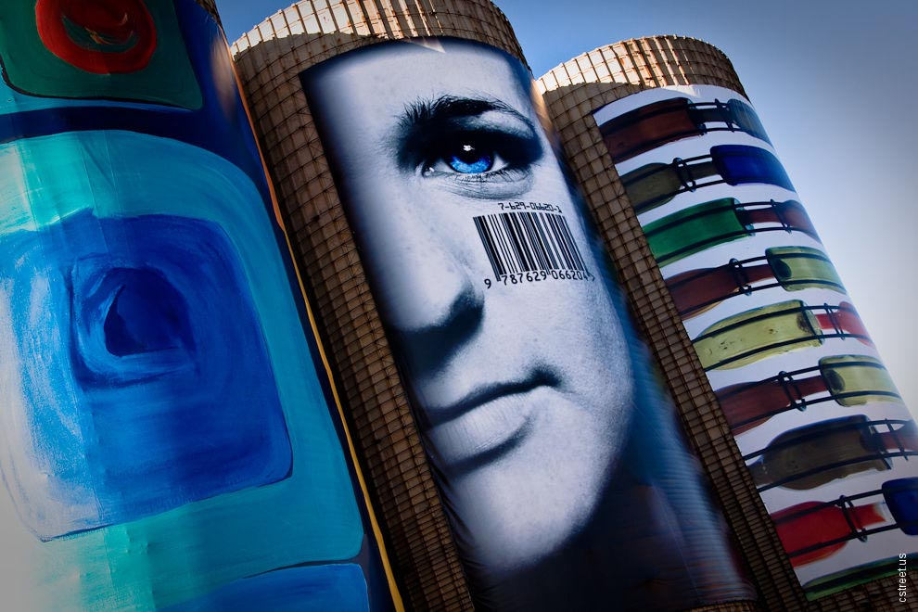
mapping the customer experience customer experience journey maps @joyce_hostyn
cstreet.us flickr
Notes:
Do you know what your organization looks like from your customer’s perspective? In the digital age, silos and organizational bureaucracy manifest themselves through your digital presence. You can bridge these silos and overcome a bureaucratic inside-out mindset by visualizing the customer (learner, elder, citizen) experience through a customer experience journey map that captures both actual and emotional aspects of the customer experience. Then, map in hand, you can use it to write great outside-in customer experiences for your organization.

Slide 2
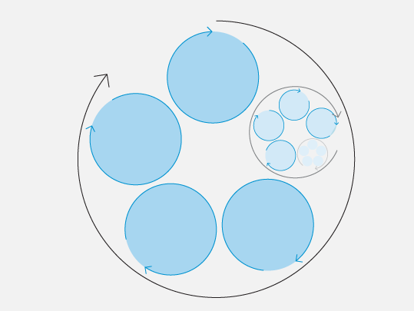
connect & attract
advocate
compelling captures imagination
orient
orienting
help them navigate the world
reverberating
‘you just have to try this’
extend & retain
generative
promise more good things
embedded
become part of their lives
interact
The Experience Cycle, Hugh Dubberly http://bit.ly/qhGLuQ
Notes:
connect and attract: the initial connection with the person and using that contact to make an effective and affective impression
orient: the overview or preview of what’s available or possible, allowing exploration and supporting the early stages of learning
interact: the completion of valuable or valued activities while delighting the senses, skilling, and establishing expectations about the overall content of the encounters
extend & retain: the person comes back for more as their expectations are raised – at the same time a significant level of loyalty and leverageable relationships are achieved
advocate: the person actively communicates their satisfaction to others

Slide 3


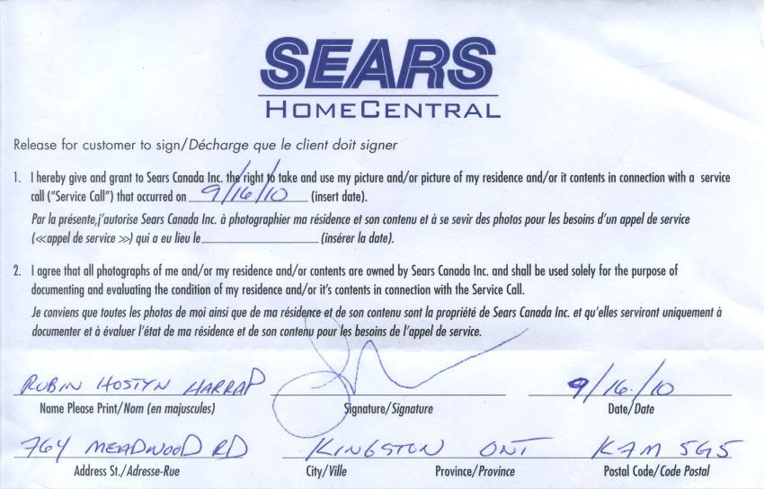
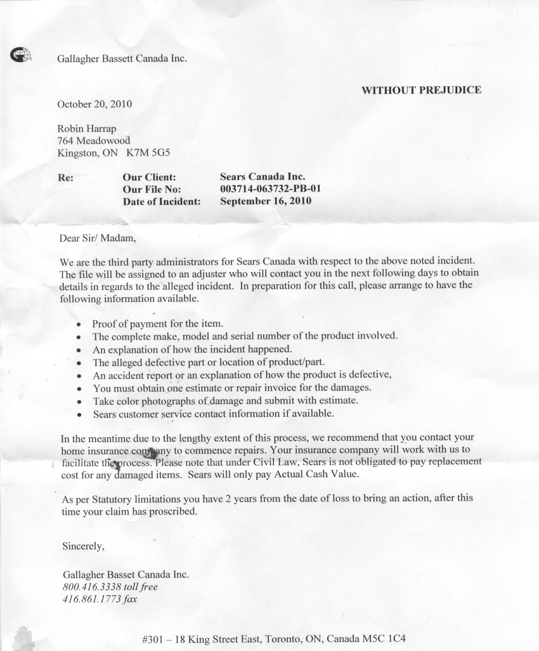
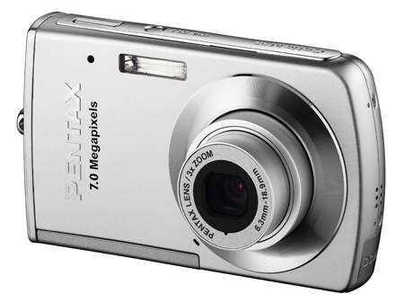




“only thing I can do is copy everything that’s happened into an email and send it on”
you misplaced the insurance claim one of the service techs filed, so he has to do another visit to prepare the claim?
so, you’re saying the service tech closed the ticket & since you don’t have an open ticket, you can’t do anything until you send out another tech to open a new ticket?
I’m calling with your issue number
no open ticket
no record of claim
make it to 2nd level service
2 weeks later
why I haven’t been called back? the visit was so the service tech could give the go ahead to replace the dishwasher!
notices damage, takes pictures & fills in clam form
brand new service shows up & asks… “why am I here? what’s wrong with the dishwasher?”
takes pictures & fills in claim form
you’ve got to be kidding me... what a way to make me feel warm & fuzzy
2 weeks later
guess they haven’t heard of the plain English campaign
months (and lots of hair pulling) later
We’ll replace the dishwasher. But a service tech has to give the go ahead. We’ll send one over.

Slide 4
connect & attract
advocate
no content to enable decision making

detract
‘you really don’t want to go through this’
no proactive education, incorrect use
orient


dissolving rubber, mould, leaking, no troubleshooting, disenchanted service tech
fail to ‘know’ me, fail to resolve issues, fail to educate during service, misplace documents
extend & retain
interact



Slide 5
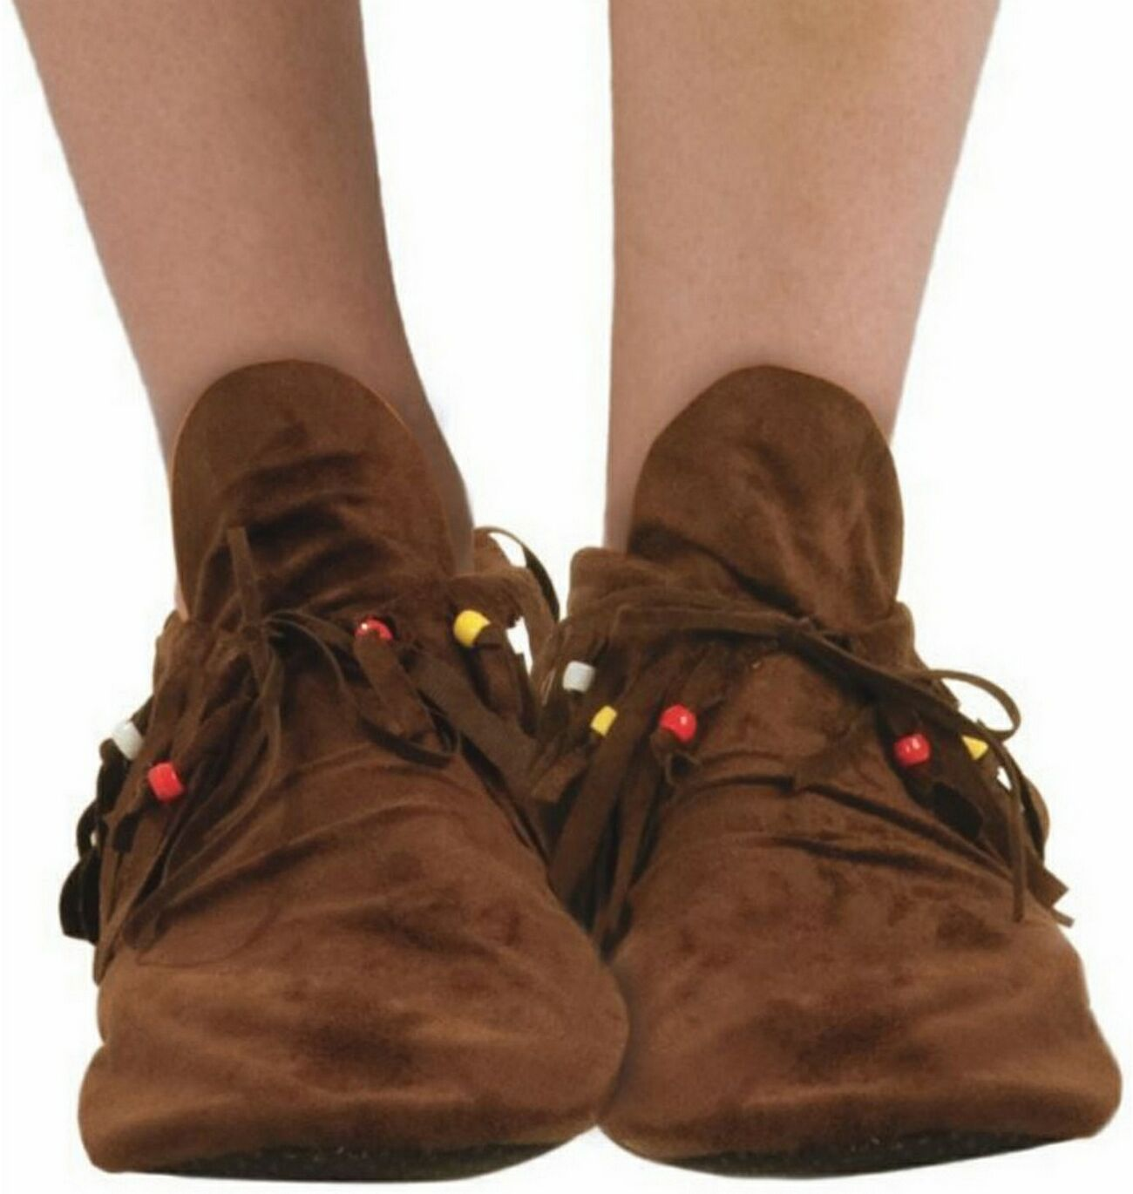
Empathy is not walking in another’s shoes. First, you must remove your own.
Scott Cook, Founder Intuit
Notes:
Delivering great experiences requires empathy – seeing what the customers sees, feeling what the customer feels. But delivering great experiences also requires deep self-awareness. Awareness of who you are as an organization, of your purpose, values, strengths and weaknesses. Awareness that you have mental maps built upon assumptions which need to be surfaced and questioned.
“People discover unseen opportunities when they have a personal and empathic connection with the world around them. For individuals, that means developing the ability to walk in other people’s shoes. For companies and other large institutions, that means finding a way to bring the rest of the world inside their walls.” - Dev Patnaik, Wired to Care

Slide 6
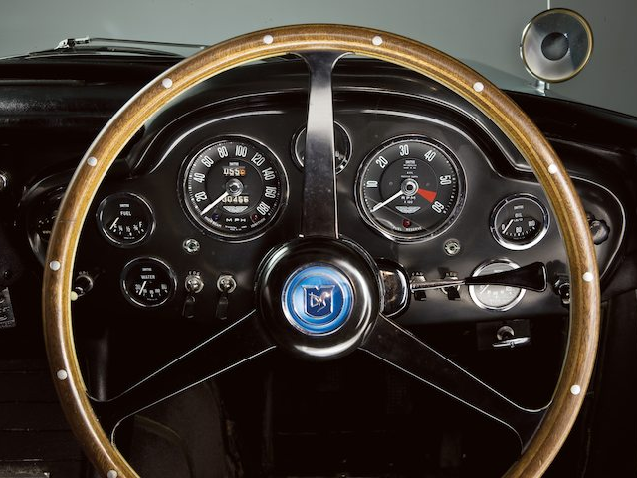
Statistics are merely indicators. Like numbers and gauges on the dashboard of a car. No single reading can advise on the health of the car. The gauges, along with the sound of the car itself, the handling, look and feel, and smell of burning rubber all combine to give an indication that your beloved motor may be under the weather.
– art of community

Slide 7
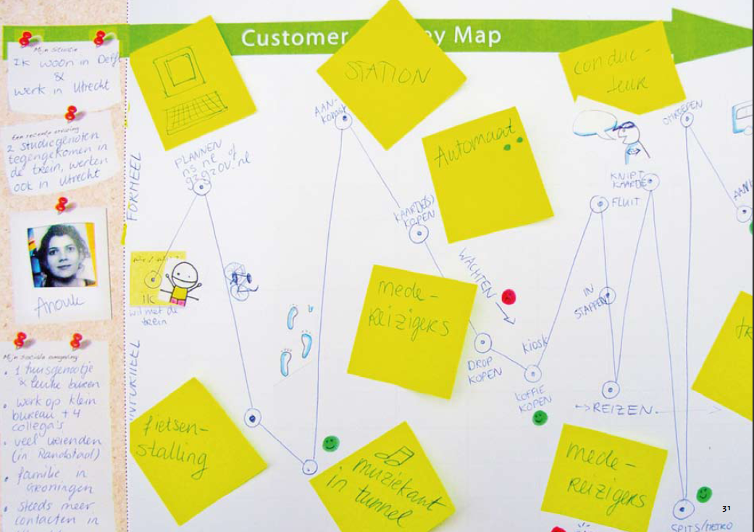
journey maps promote emotional contact with insight, distilling research into a concise, visually compelling story of the customer’s experience
design for service???? this is service design???
Notes:
While audiences cannot see themselves in raw numbers and bullet points, they can see their desires and concerns reflected in the plight of your story’s “hero.” In one rhetorical stroke, the right story establishes a context for your message and a framework for its elaboration, and, most important, creates an empathetic connection between yourself and your audience. – Using Stories to Persuade, HBR

Slide 8
experience as story

Slide 9
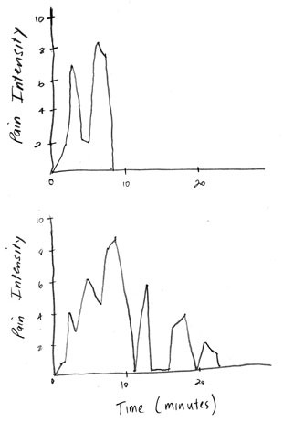
Emotions determine memory
when we recount a memory, we’re sharing the experience of the story we created, not the actual experience
http://bit.ly/p5Cgfq
Notes:
The remembering self uses story to make sense of the world. As soon as we experience something, we fit it into the story in our heads. What we keep from our experiences is a story. Therefore, when we recount a memory, we’re sharing the experience of the story we created, not the actual experience. And when we make a decision, we choose between memories of the experience of the story. The experiencing self has no voice in the choice. And what defines stories? Most of the individual moments of an experience are lost and don’t make it into the story we remember, except for changes, significant moments, and endings. Take, for example, endings. Kahneman uses colonoscopies to illustrate the importance of endings on memory. In studies that measured how much patients actually suffered (as measured by their experience at the time) versus how much did they think they suffered (based on their memories of how bad the experience was), patients that experienced more pain remembered it as less painful if the operation ended on a less painful note. They were able to give patients a better story of their experience by prolonging the operation.

Slide 10
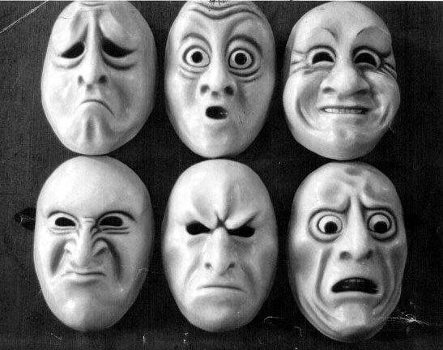
customers always have an experience
(good, bad, or indifferent)
Managing the Total Customer Experience, MIT Sloan http://bit.ly/og9wJx
Notes:
Managing the Total Customer Experience, by Leonard L Berry, Lewis P. Carbone and Stephan H. Haeckel.

Slide 11
Consciously and unconsciously filter clues and organize them into rational
our emotional brain (95%)
and emotional
our rational brain
impressions

Slide 12
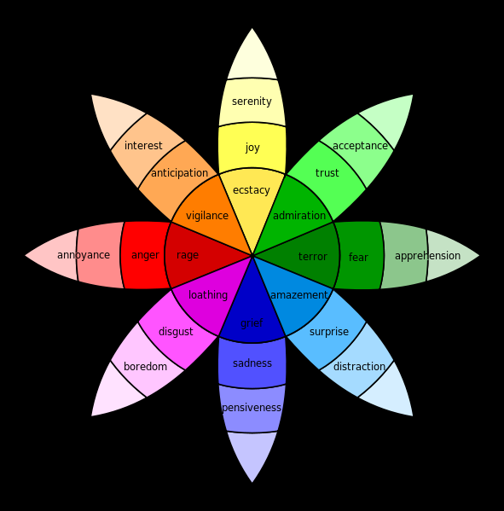
emotions influence what we remember, how we evaluate encounters,
& our decisions
Designing the Soft Side of Customer Service, MIT Sloan http://bit.ly/oYEQIX

Slide 13


trust
is a primitive psychological variable essential to building relationships

Slide 14
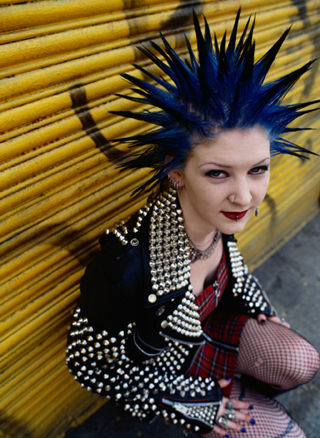
control
over our environment and knowledge of how events are going to evolve is fundamental psychological need

Slide 15
experiences
are the stories you tell yourself
as a result of interactions
with emotional resonance
processes
misery moments
inside out
systems
which happen at touchpoints
Brandon Schauer, The (Near) Future of Managing Experiences http://bit.ly/pMumzn
Notes:
Diagram modified from Brandon Schauer’s The (Near) Future of Managing Experiences http://bit.ly/pMumzn
Systems: Companies have core systems that serve as the foundation for their efforts. The most obvious example are IT systems — WCM, ECM, ERP, accounting, CRM… But also facilities — such as real estate, architecture, and infrastructure.
Procedures: The policies, processes, and business rules that provide the "logic" for how the business is run. Some of this is embedded in the systems, some of this is taught to employees.
Touchpoints: The liminal spaces where engagement with customers occurs. Typically considered through channels such as in-store, call center, postal mail, or online. Interactions: The activities in which customers engage. Any business supports dozens, if not hundreds of interactions. With a bank, you can deposit money, withdraw money, write a check, pay a bill, move money between accounts, open or close accounts, apply for a loan, etc. etc.
Experiences: The sum of what the customer takes away from the interactions they've had with you. A memorable event – with a beginning, middle, and end.

Slide 16
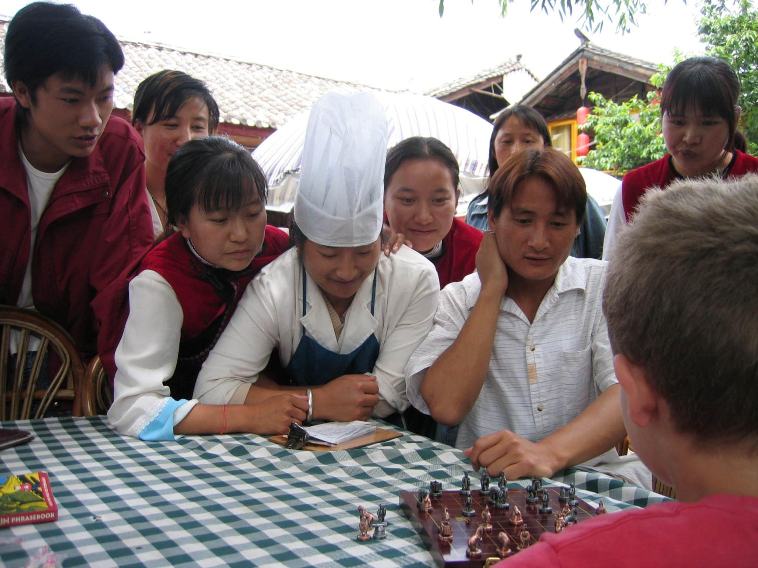
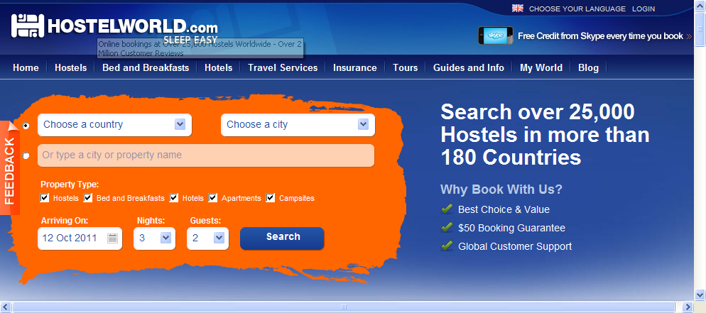
Notes:
experience is the meaning we take away, the story we tell ourselves, the change in how we see the world

Slide 17

Customer experience… is the full, end-to-end experience.
It starts when you first hear about Amazon from a friend, and ends when you get the package in the mail and open it.
Jeff Bezos

Slide 18

Customer experience is the perception that customers have of their interactions with an organization.
Bruce Temkin

Slide 19
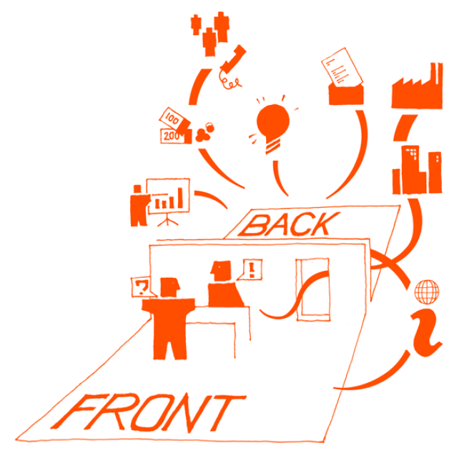
Rather than creating a set of messages and images that associate a company and its products with emotional values, experience pioneers will be focused on creating a business that delivers the brand as an experience incorporating these values.
How to Lead the Customer Experience http://bit.ly/pbHAXX
Notes:
Image from Design for Service, www.designforservice.com
Rather than creating a set of messages and images that associate a company and its products with emotional values, experience pioneers will be focused on creating a business that delivers the brand as an experience incorporating these values. And this, we assert, is the real transformation, the real meaning, and the real potential of becoming a customer-centric business. Touchpoint are the places where process, systems, data all intersect - often the fault line between different divisions, functional, and geographic areas. This is the real transformation, the real meaning, and the real potential of becoming a customer-centric business.
- How to Lead the Customer Experience http://bit.ly/pbHAXX

Slide 20
brand as experience
design interactions
connect emotionally
foster sense of control
build trust and relationships
help people make informed decisions
engage in conversation
magic
moments
outside in
Notes:
Customer experience design is taking the customer views of the interactions to understand the emotional bond between the brand and customers. It requires a common understanding of the customer journey, then align the company actions to build emotional bonds. - Idris Mootee

Slide 21
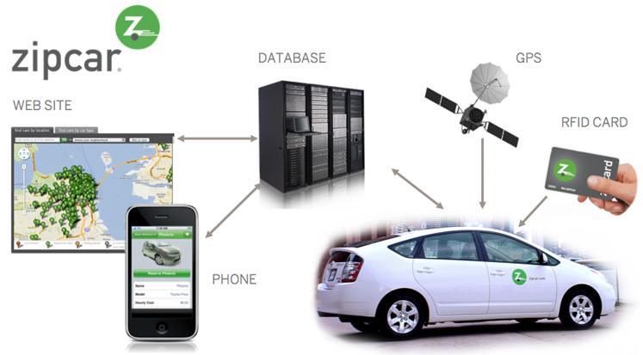
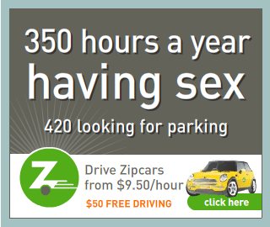
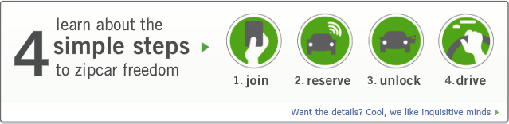
lifetime experience…
from the first time they go to our web site through the last time they ever use one of our cars and decide not to be a member any more. [We] map that cycle and follow it.
Scott Griffith, CEO Zipcar
Notes:
integrated ecosystems open up possibilities in a way that isolated touchpoints can’t

Slide 22
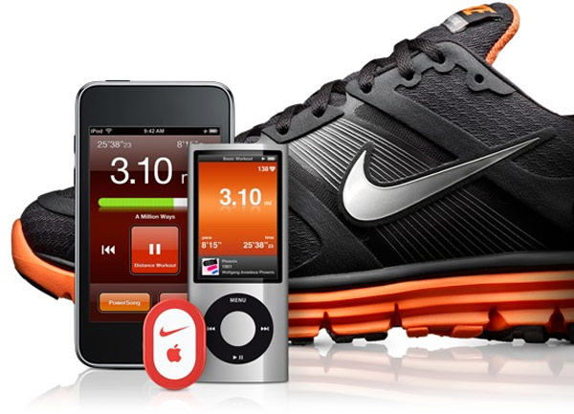
We don’t do advertising any more. We just do cool stuff, it sounds a bit wanky, but that’s just the way it is. Advertising is all about achieving awareness, and we no longer need awareness. We need to become part of people’s lives and digital allows us to do that.
Simon Pestridge, Nike UK
Notes:
In my opinion Nike have created a customer experience where the foundations are set in health and fitness. They enable each individual to assemble the components that they need within the framework they provide to manage their own personal fitness experience. The framework is the commodity, the experience is personal. I’ve said before and I will say again, “You can’t commodotise the experience – that’s the differentiating part – it’s a personal and, at times, emotional connection between the person, the activity or interaction, and the brand”. You can however provide the framework (as a commodity) to enable the experience to happen. The Running Man, A Customer Experience Tale http://adobe.ly/oj3Ofs

Slide 23
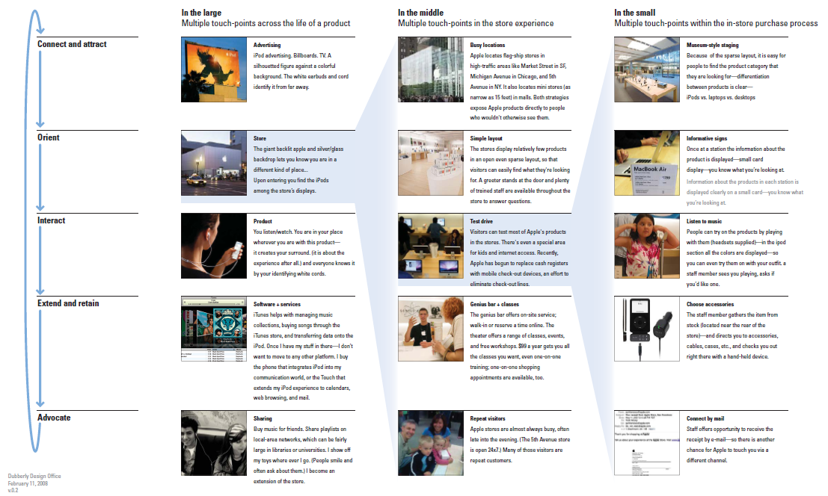
You’ve gotta start with the customer experience and work backwards to the technology.
Steve Jobs
Notes:
Apple, A Love Note: The Power of an Ecosystem http://bit.ly/qECRka

Slide 24
what is the experience you’re trying to deliver?

Slide 25
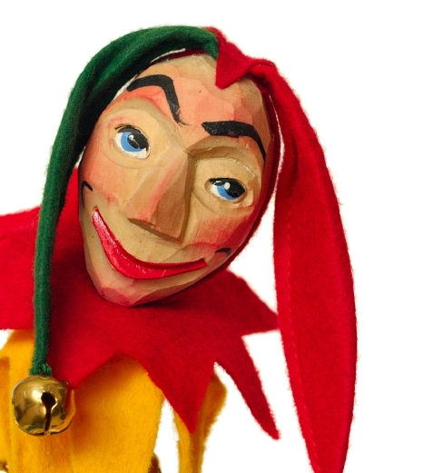
ask provocative questions
what will the future look like for
information rich environments
learning
aging
living a healthy life
Notes:
journey as story is a tool to change your organization, business, university, library
The best servants of the people, like the best valets, must whisper unpleasant truths in the master's ear. It is the court fool, not the foolish courtier, whom the king can least afford to lose. - Walter Lippmann, A Preface to Politics

Slide 26
who is your who?
Notes:
While audiences cannot see themselves in raw numbers and bullet points, they can see their desires and concerns reflected in the plight of your story’s “hero.” In one rhetorical stroke, the right story establishes a context for your message and a framework for its elaboration, and, most important, creates an empathetic connection between yourself and your audience.

Slide 27
aka the hero
(not passive user)

Slide 28
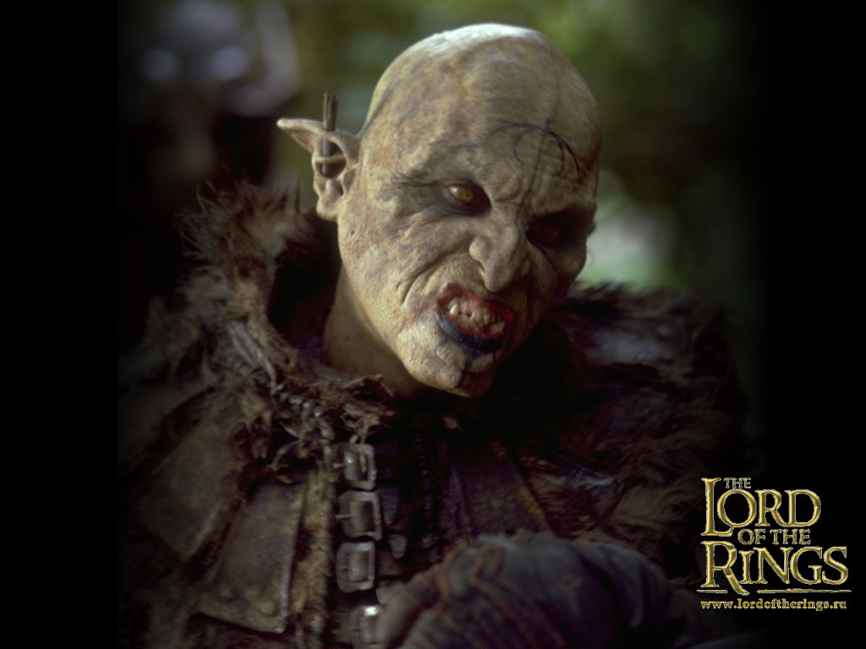
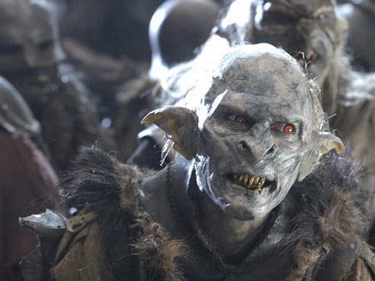
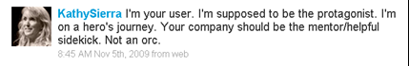

Slide 29
sick patient
consumer of health
products and services
Reframing Health, Hugh Dubberly

Slide 30
aging as medical problem to manage
elder
nursing home
orderlies, aids, nurses
receive care
human habitat (relationships)
Shahbazim
give and receive care

Slide 31
student
lifelong learner

Slide 32
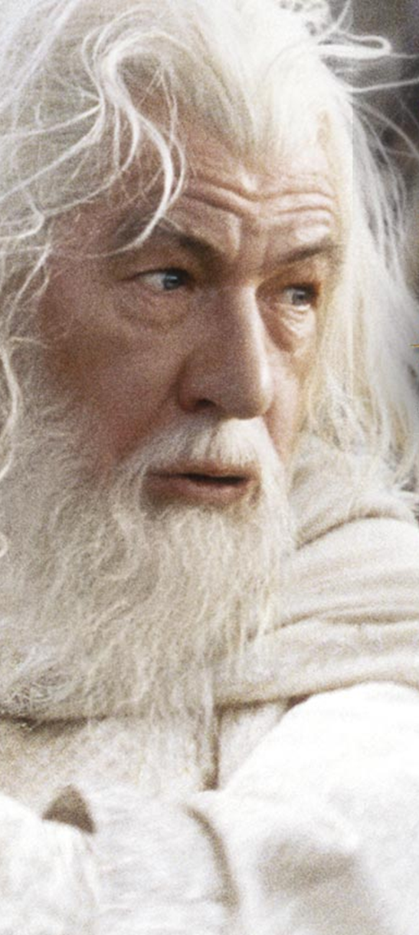
provider of applications and services to passive users
mentor of
heroes who actively chart their own journeys

Slide 33

What do they
THINK & FEEL & FEAR?
what really counts
major preoccupations
worries & aspirations
What do they
HEAR?
boss
colleagues
influencers
friends
What do they
SEE?
environment
friends
colleagues
what work offers
What do they
SAY & DO?
attitude in public
appearance
behavior towards others
PAIN
fears | frustrations | obstacles
GAIN
wants/needs | measures of success | obstacles
Source: XPLANE and Business Model Generation by Alexander Osterwalder
Notes:
What do they see in their environment?
what does it look like? who surrounds them? who are their friends, colleagues, influencers, enemies? what types of messaging, demands, requests, influences are they exposed to daily? what problems do they encounter?
What do they hear? How does the environment influence them.
what do their colleagues, boss, friends say? who really influences them & how? which communication channels are influential?
What do they really think and feel?
what is really important (that they might not say publicly)? imagine their emotions… what moves them? keeps them up at night? what are their dreams and aspirations?
What do they say and do in public?
what is their attitude? what might they be telling others? think about conflicts between what they might say and what they really think and feel
What is their pain?
frustrations? obstacles standing between them and what they want or need to achieve? what risks might they fear taking?
What do they gain?
what do they truly want or need to achieve? how do they measure success? what are they measured on? what are some strategies they might use to achieve their goals?
What’s their sacrifice to adopt your idea?
What beliefs or ideals do they need to let go? How much will it cost them in time or money?
What’s the perceived risk?
Are there physical or emotional risks they will need to take? How will this stretch them? Who or what might they

Slide 34
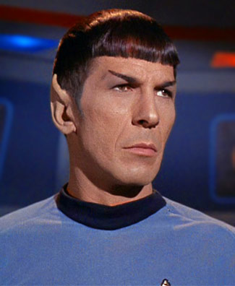

heroes aren’t Vulcans
people are ruled by emotion, not logic
what does this do?
how much does it cost?
what are the features?
how does this make me feel?
does it provide meaning or pleasure? how will it affect me?
Notes:
rational: tasks, goals, preferences
emotional: emotions, context, meaning

Slide 35
elder
learner
ask what value as a mentor you offer your hero
as they chart their journey

Slide 36
what are they experiencing?

Slide 37
map the story of their
current journey
(an experience audit)
Notes:
While audiences cannot see themselves in raw numbers and bullet points, they can see their desires and concerns reflected in the plight of your story’s “hero.” In one rhetorical stroke, the right story establishes a context for your message and a framework for its elaboration, and, most important, creates an empathetic connection between yourself and your audience.

Slide 38
collect internal insights
develop hypothesis
research customer processes, needs, perceptions
analyze customer research
map the journey visually
Bruce Temkin, Mapping the Customer Journey http://bit.ly/nsdsbf
Notes:
collect internal insights: surface observations and ideas about customers and their experiences, help identify sources of customer data, and get stakeholders involved early
internal hypothesis: document internal insights, share with stakeholders, provide framework or prototype to build out research-based maps
research: capture insights from all touchpoints (ethnographic studies or social media outlets)
analyze the research: how customers interact, what they want from each interaction, and how they feel about each interaction today
map: translate into simple, visual representation of customer processes, needs, and perceptions

Slide 39
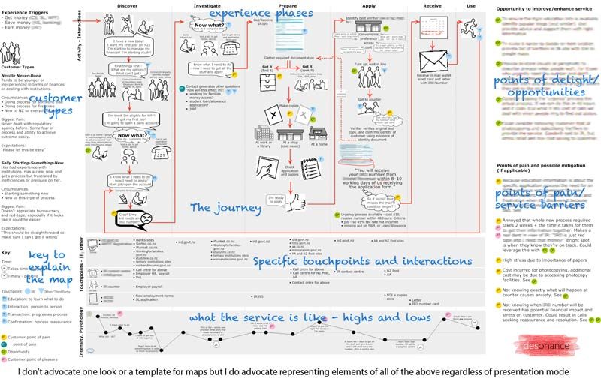
Map the journey visually
desonance http://bit.ly/nTc0fz
Notes:
Customer experience journey maps take into account not only what happens to a persona, but also their responses, how they feel about their experiences. By breaking down an experience into individual interactions, maps make needs and emotions easier to recognize.

Slide 40
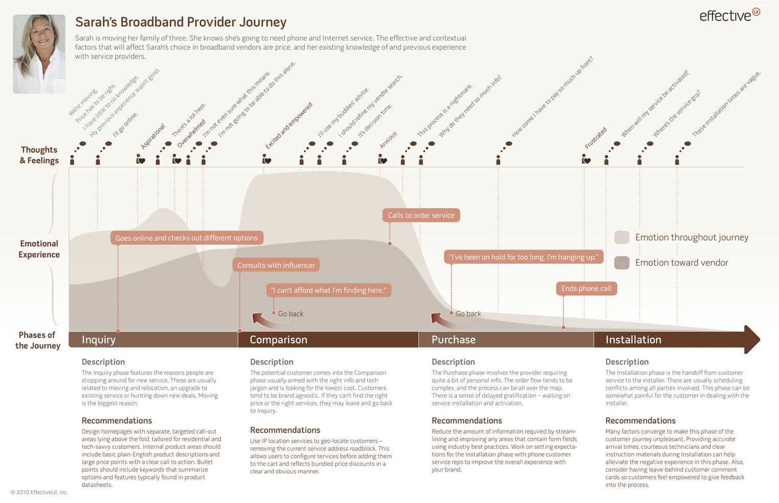
Value of Customer Journey Maps http://bit.ly/pDdyyX

Slide 41
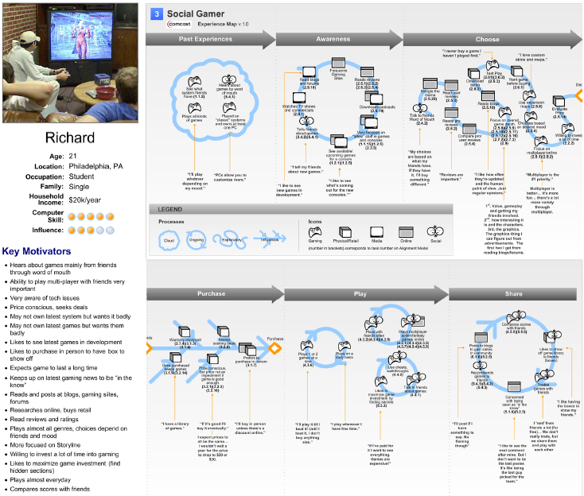
nForm http://bit.ly/pmyNma

Slide 42
Reporting the crime
Police investigation
Before the trial
At court
After the trial
Reported crime immediately. Police ‘very good’ – told him what to do and who was coming. Felt secure
Identified attacker – ‘felt good, this will be straightforward’
Positive
Phone conversations with detective – ‘kept in touch’
Gave statement in police car – felt were ‘helping him’
Detective gave him background to accused: first offence, had been held since arrest. ‘Felt a bit better’
Only communication with detective. Happy to explain situation
Drove him home - grateful, but didn’t feel like standard service
Called up to identify criminal on computer system seemed ‘efficient’
Case submitted to CPS. Unclear where next contact from. Had to ask detective
Judge asked if he would like to sit – only introduction
Received call from detective
Would report a crime again, because found out defendant had been held for 5 months. But court experience was a ‘waste of time’
Level of satisfaction
Pack from Witness Service. Personal contact became formal. No information about process ahead
Told to come back next day. Not a big problem
Neutral
Drove around looking for attacker – ‘waste of time’ as in marked car
Identity parade. No coaching, no reassurance wouldn’t meet attacker
In locked witness room – ‘cut off’
Had to go to the detective – ‘foreign territory’. Police station ‘disconcerting’
Little contact with anyone – only detective
Jury is a ‘sea of faces’
Worried attacker could come to house
Gave formal statement. Worried whether justice would be done. Detective seemed ‘dim’. Changed the statement into his own words
Few days before trial, still no information on process
Food terrible – had to go out
Called Witness Service as wanted to speak to barrister. Told to arrive early on the day. Seemed ‘disorganised’
Detective told him ‘You should have said…’ Too late now
Didn’t see barrister, and detective late
Witnesses have to be flexible but judges aren’t (lunch 12-1). Annoying
Barrister not very confidence inspiring
Accused got off
Asked to see barrister again. Did – but he wasn’t informative
Other reason was that a detail of appearance had changed. Frustrating, ‘knew it was him’
Didn’t go into court at all on day 1. No information on why. Lack of information most frustrating thing
Called - court room an alien situation. From a tiny room to a theatre. Everyone else in the know
Got off because he had been identified on computer system before line-up (which made evidence invalid. Police knew this was a problem, so why didn’t victim?
Negative
September
March
Source: DCA, Victims of crime http://slidesha.re/qMsHAc
Notes:
This is an example of some customer journey mapping which was done in MOJ to understand the experience of court users (witnesses, victims, jurors and also defendants themselves). Previously they had focused on process maps and major customer satisfaction research, but they had never tracked the journey through the customer’s eyes and by doing so, they found out some fascinating facts – e.g. satisfaction levels or positive vs negative experience can be driven by small details (e.g. jurors being thanked by the judge for their contribution), or having to queue in the canteen at lunch time with other court staff.
Found it particularly powerful to drive change in perception amongst policy community – and it has successfully driven a number of changes – e.g. in training / induction of court staff; front of house experience; also better joining up of different agencies (e.g. recognising that expectations set by police in persuading jurors to give evidence cannot always be met)

Slide 43
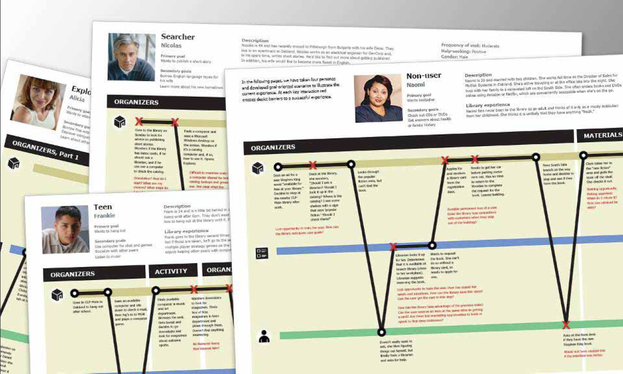
Research the customer personas
MAYA Design, Carnegie Library of Pittsburgh, http://slidesha.re/qLhlV8

Slide 44
Identify important journeys to map
actual: travel to an event
transactional: apply for old age pension
experiential: live in an old age home
emotional: mental journey experienced over time (aging)
relationship building: development of a relationship over time (Shahbazim)
rite of passage: major life change (retirement)

Slide 45
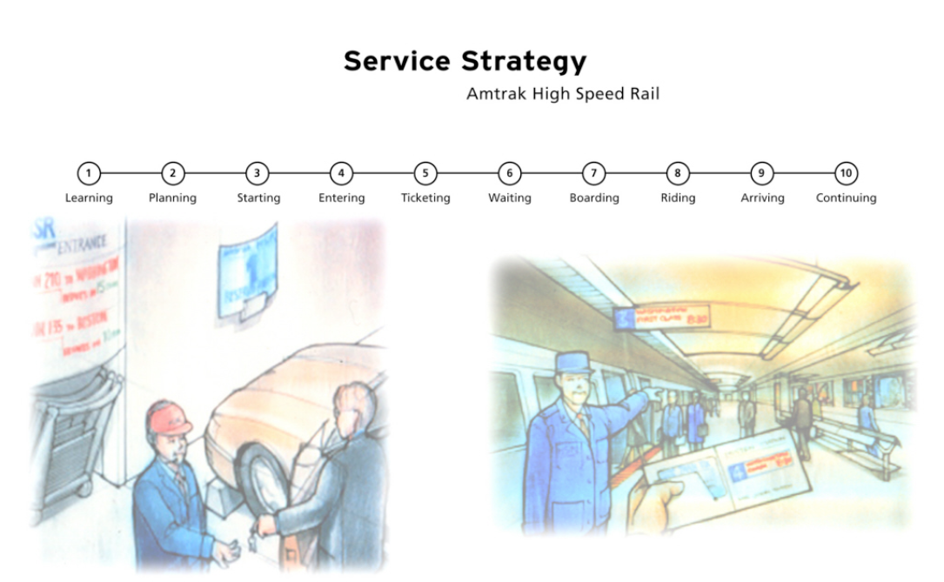
Break the journey into stages using your customer’s point of view
Innovation through Design Thinking http://slidesha.re/q3njn7
Notes:
Service Strategy Amtrack High Speed Rail

Slide 46
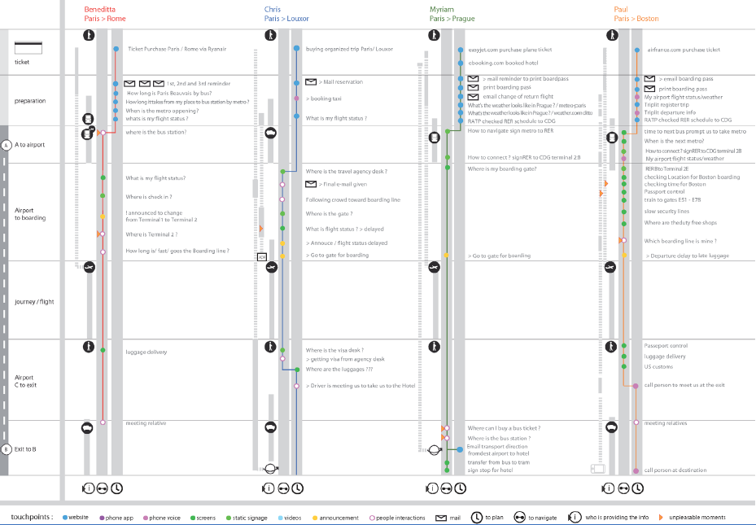
Capture each persona’s unique experience
Travel Experiences by Christopher Tallec http://bit.ly/nLnHp8
Notes:
http://bit.ly/nLnHp8 Locating Value with Alignment Diagrams, Parson’s Journal for Information Mapping
Four travel experiences recording the interactions between service providers and four different users on international trips - Christopher Tallec. The touchpoints of each journey are aligned in two dimensions. Each set of color-coded touch points are located vertically between the customer action on the right and the transportation service on the left. At the same time the journeys are divided into seven stages, with the touch points aligned horizontally. By looking across the top of the diagram we can see the concentration of website, email, and phone application touchpoints in the early stages, followed by the increased reliance on signage, dynamic screens, and interaction with other people as the journeys continue.

Slide 47
Capture the backstory that begins before you enter the stage
Have a personal mobile phone for keeping in touch with family.
Use web at home.
past experience
what else I’ve used
become aware
learn about it
first use
how do I get started?
decide to learn
is this working for me?
build experience
intermittent use
become proficient
it’s how I do things
champion
advocate to others
Consult binders of procedures.
Poor perception of enterprise apps based on prior experience.
Store documents in email, personal drive, and shared drive.

Slide 48
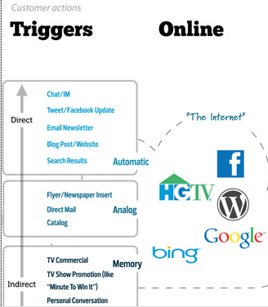
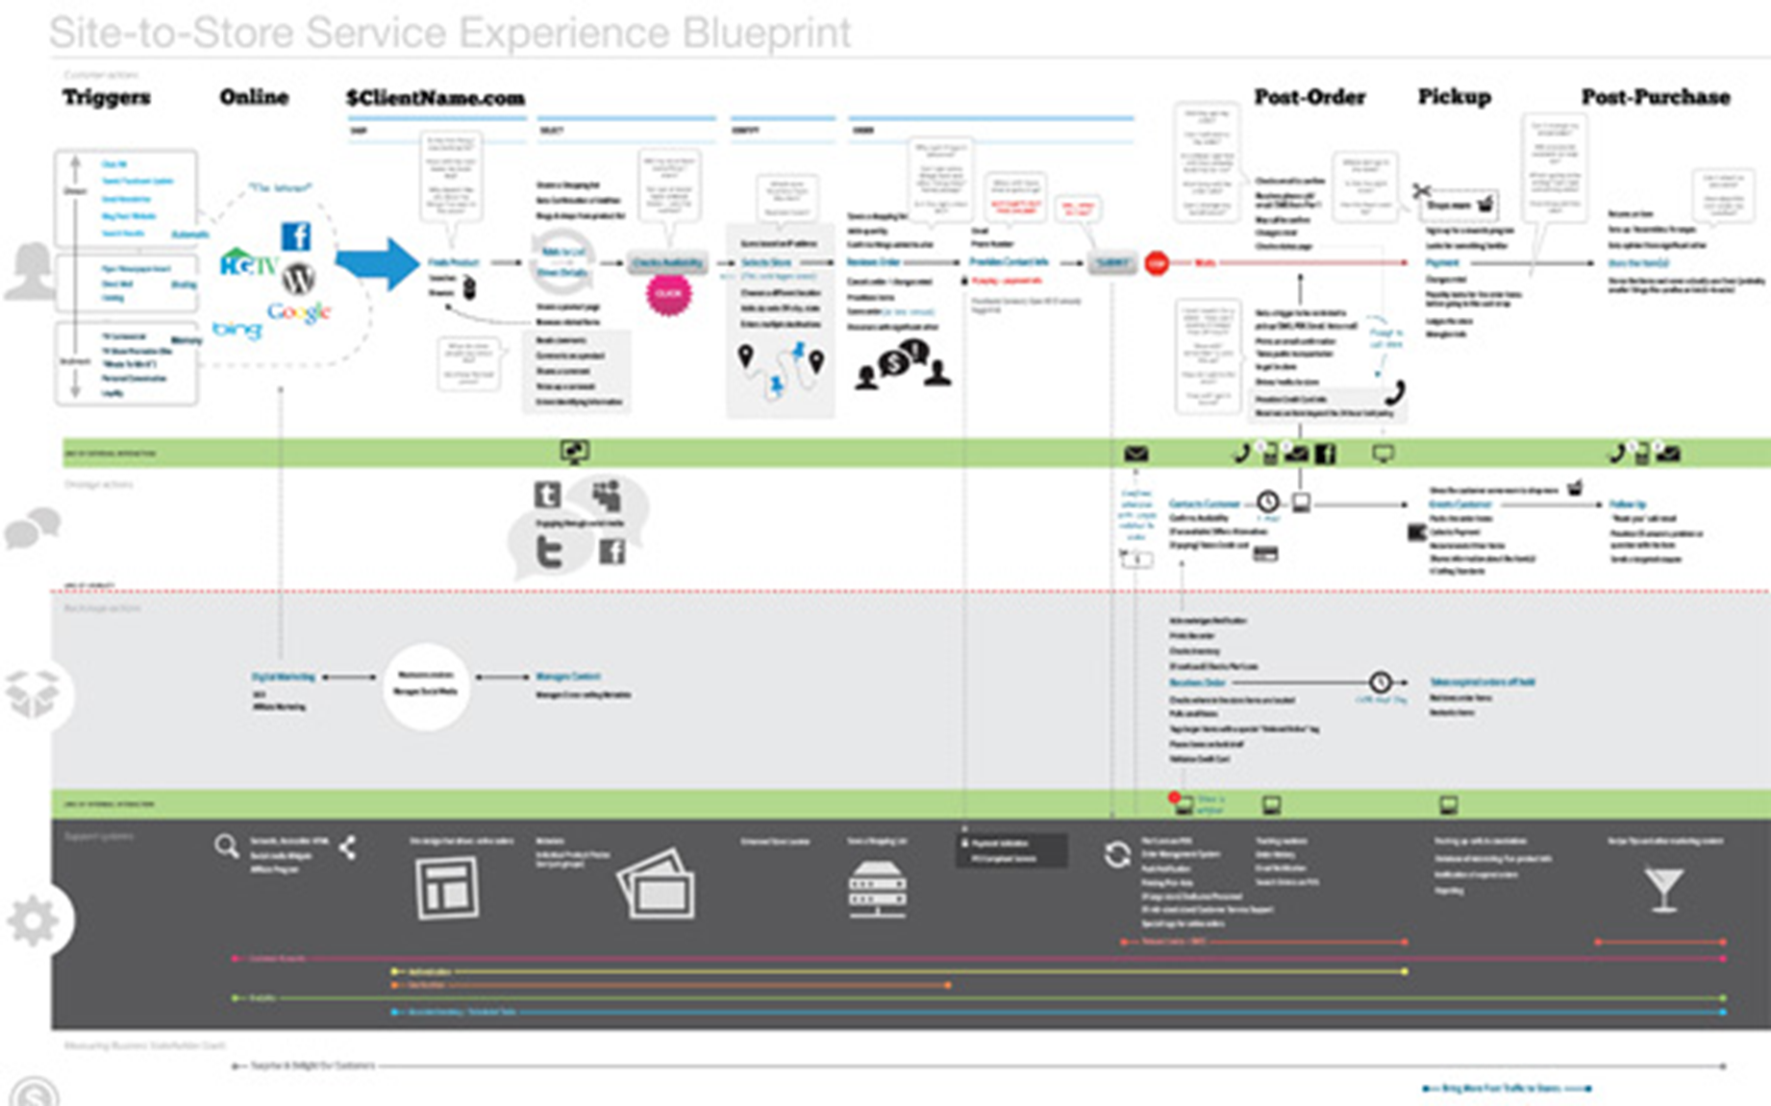
Identify the triggers into the experience (voluntary or propelled)
Captura http://bit.ly/mWoPu9
Notes:
Captura asked “How do we take what could feel like a handicapped ecommerce experience and instead make it feel like an augmentation to the in-store experience? This service map detailed the emotional journey of their online customers and the supporting features and systems we’d need to provide to ensure conversion.”

Slide 49
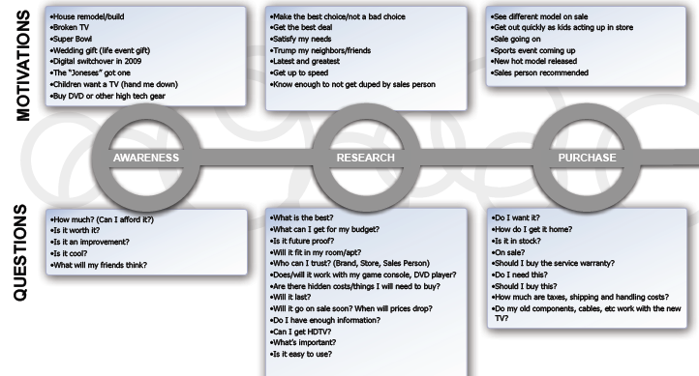
And the motivations triggering progress between stages
Home Theatre Journey by Frog Design http://bit.ly/n2fsBM

Slide 50
Inventory touchpoints where interactions occur
physical
virtual
human
Notes:
Spaces where interactions occur. Channels such as in-store, call center, email, advertising, website, product… physical, virtual, human

Slide 51
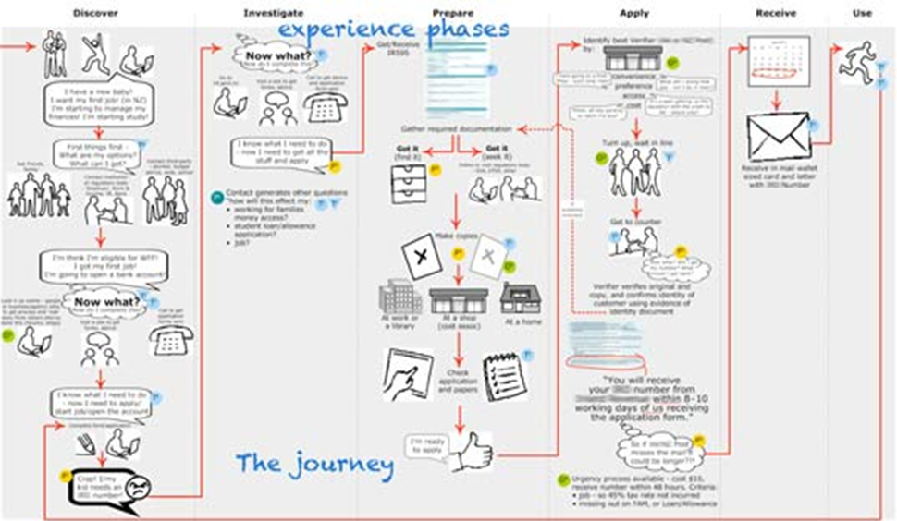
Document activities at each touchpoint
Notes:
People’s behavior is activity focused. What are the activities in which a customer persona engages with your organization? Anything from viewing a marketing message, visiting a website, learning about your organization, using a product or service, or calling customer service to solving a problem.

Slide 52
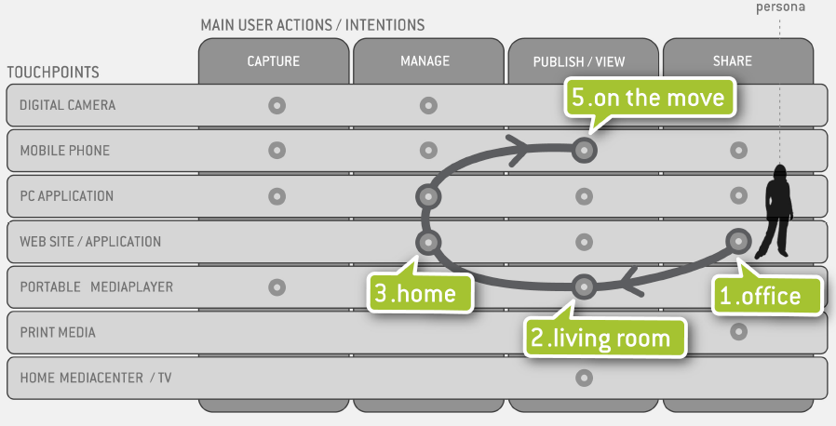
Connect the dots across multiple touchpoints
Gianluca Brugnoli’s Photography Touchpoints Matrix http://bit.ly/nLnHp8
Notes:
A possible journey across the photography eco-system. Different touchpoints that are part of the system (vertical axis) and the different actions that are supported by the system (horizontal axis). Allows a quick visualization of what is possible in terms of interaction with the different touchpoints. After that, the introduction of personas drives the representation of several specific journeys within the graph and the comprehension of the possible user scenarios.

Slide 53
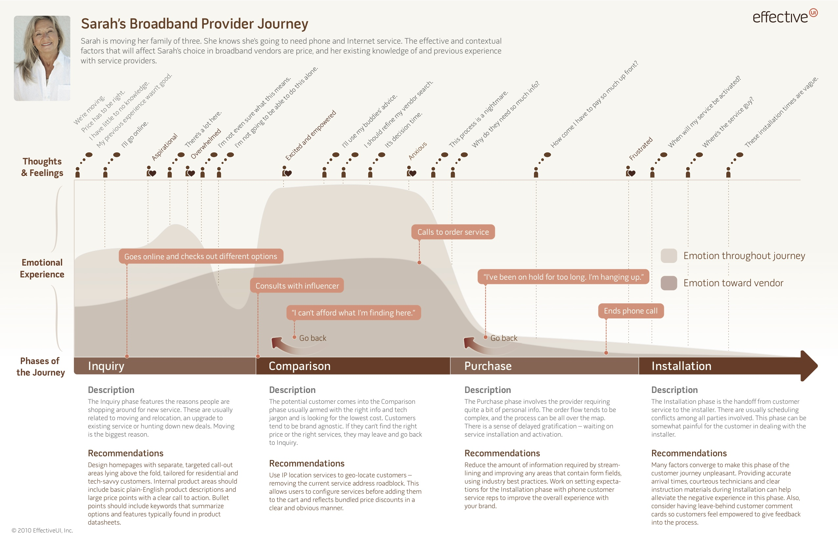

Highlight thoughts and feelings at each interaction

Slide 54
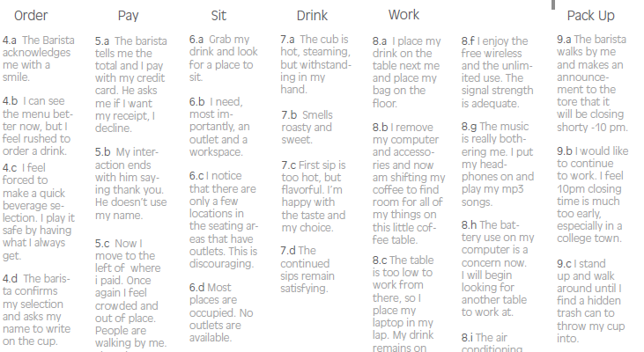

Starbuck’s Customer Experience Little Springs Design http://bit.ly/oGtEqL

Slide 55
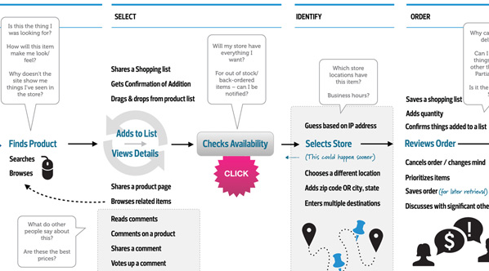
Capture questions running through a persona’s mind

Slide 56
Highlight barriers and points of pain blocking move to next stage
value
productivity
simplicity
convenience
risk
fun & image
uncertainty
awareness
cost
structural

Slide 57
Visualize emotional highs and lows

Slide 58
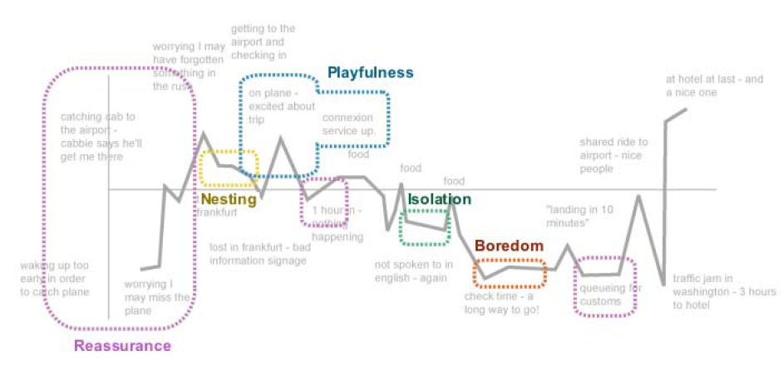
Reflect mood of the emotional journey
Innovation through Design Thinking http://slidesha.re/q3njn7
Notes:
Mood-o-gram: one person’s emotional journey
The strength of our emotions generally corresponds to the relative importance we place on the outcome. According to appraisal theory, five factors cause us to experience an emotion or some combination of emotions:
1. The change in outcome improves our situation or makes it worse.
2. The new outcome is associated with a penalty or a reward.
3. The new outcome is certain or just a possibility.
4. The causal event is significant or powerful, and its resultant change difficult to cope with; alternatively, the event is not very significant and the changes are easy to cope with.
5. You are responsible for the event and incumbent change; alternatively, an outside agency is responsible for the event and change.
Appraisal theory makes it possible systematically to analyze customer-facing processes and anticipate customer emotions. We refer to the service flowcharts that describe how customers feel as “Emotionprints.”
http://www.eiu.com/report_dl.asp?mode=fi&fi=817571066.PDF&rf=0

Slide 59
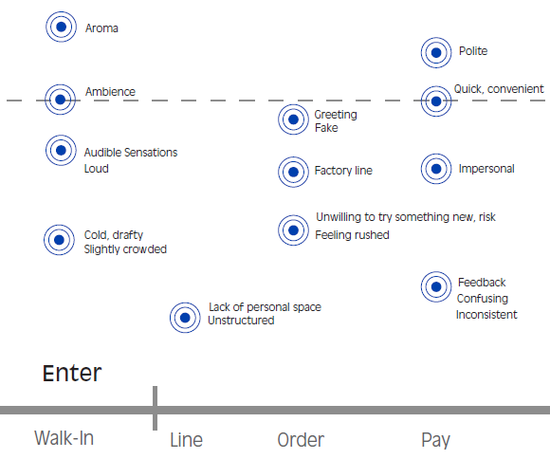
Map emotional (sensory) clues at each stage
visual
auditory
smell
tactile
taste
Notes:
Emotional/experience clue is anything that can be discerned, perceived or sensed — or recognized by its absence. Experience cues answer questions like: what sort of people work here? what do they care about? Highlight images, characteristics, and personalities that make the brand memorable… experience signposts create anticipation and signal arrival
recognize and connect with customers and their affinities
define experiential zones and destinations
move you through the experience
create and modulate expectations
signature brand values and performance characteristics
sign brand identify and build cumulative brand imagery
number and diversity

Slide 60

an emotional clue is anything that can be discerned, perceived or sensed (or recognized by its absence)
Notes:
Emotional/experience clue that reduced air-rage incidents: “It’s hard to be nasty to a girl in a sarong kebaya. Put them in pants, and passengers think they can take more abuse.” Singapore Girl - You're A Great Way To Fly Female flight attendants wear designer dresses and receive intensive training in body posture, grooming, and voice tone. The epitome of Asian grace and hospitality, the Singapore Girl been synonymous with Singapore Airlines since 1972, symbol of impeccable service standards.

Slide 61
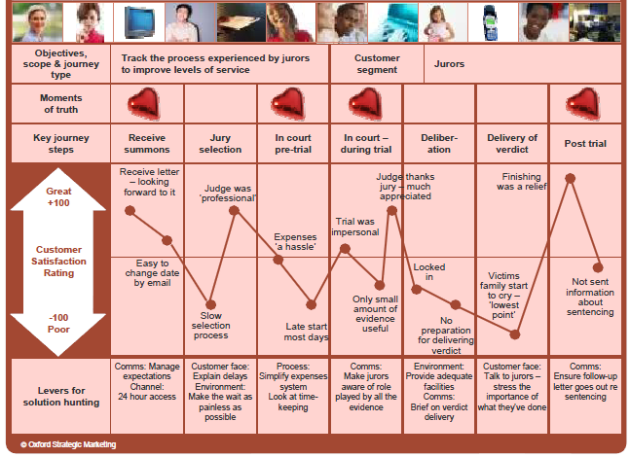
Highlight moments of truth
forms opinion
turns corner
makes decision
determines the perception of value
http://slidesha.re/qMsHAc
Notes:
Critical opportunity for good or bad brand customer experience or brand impression.

Slide 62
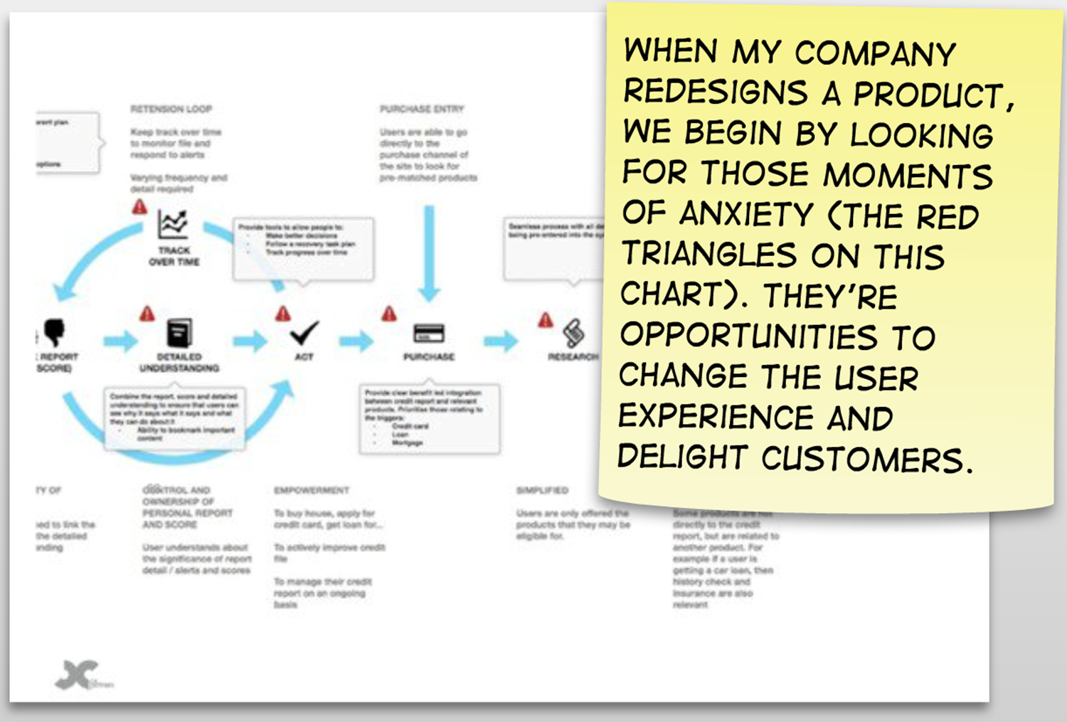
Mark moments of anxiety
Designing for Delight, @gilescolborne http://slidesha.re/c7rQ1c

Slide 63
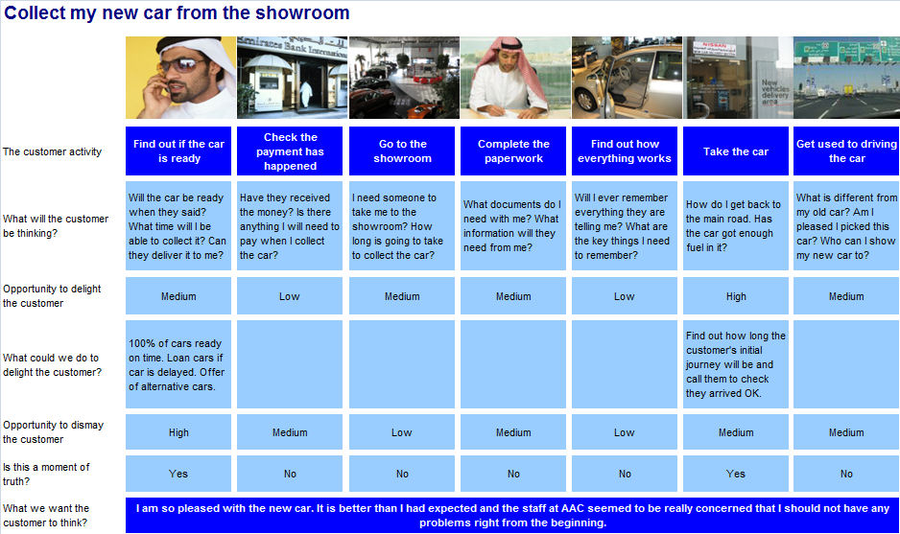

Slide 64
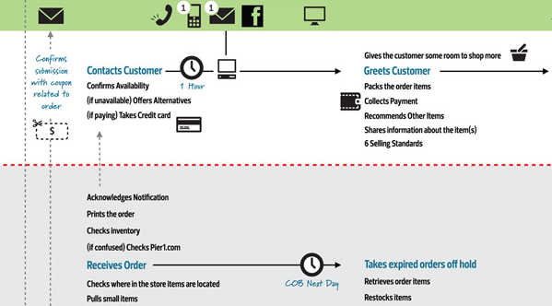
Extend with back stage interactions

Slide 65
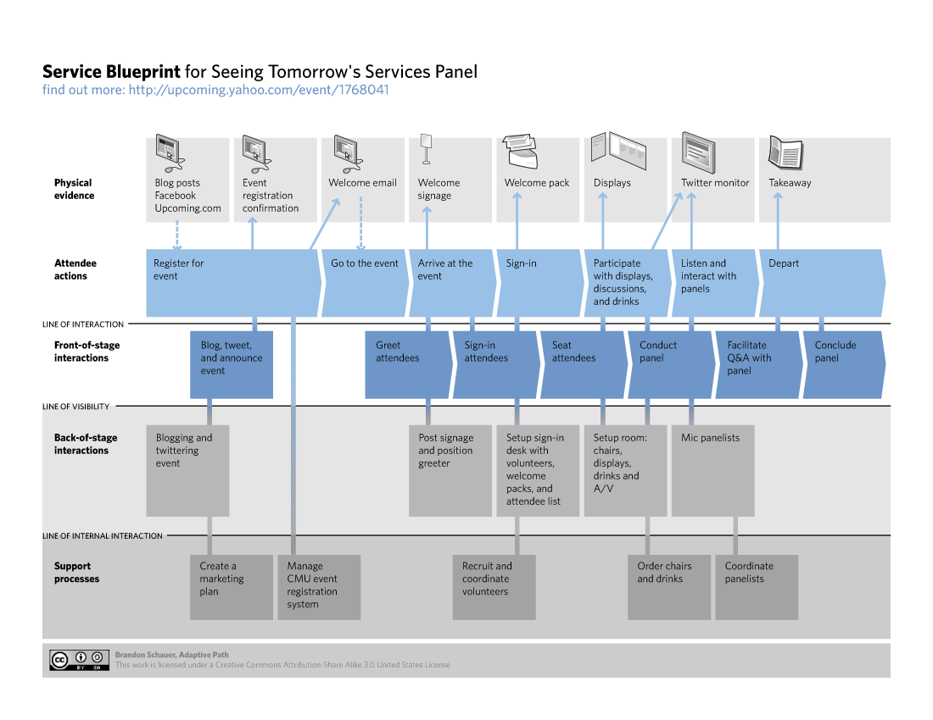
And support processes

Slide 66
key journey step
a step along the journey
touchpoint
place where you interact with or touch the main character - website, phone, product interface, help, face-to-face, newsletter, demo, social media, advertisement, event, magazine, reception, parking lot…
artifacts
content, objects, emotional cues
experience (thoughts, feelings, actions)
positive
neutral
negative
moment of truth
what’s the importance of this touchpoint?
opportunities
ideas for being proactive, great recovery, to combine or eliminate – possible to find a purple cow for wow or breakthrough experience?
levers
how to move them along to the next step (actions, emotions, touchpoints, other factors)
metrics
time, volume, action, satisfaction…
emotions to evoke
how do you want customers to feel?

Slide 67
key journey step
touchpoint
experience (thoughts, feelings, actions)
moment of truth
opportunities
levers
metrics
emotions to evoke

Slide 68
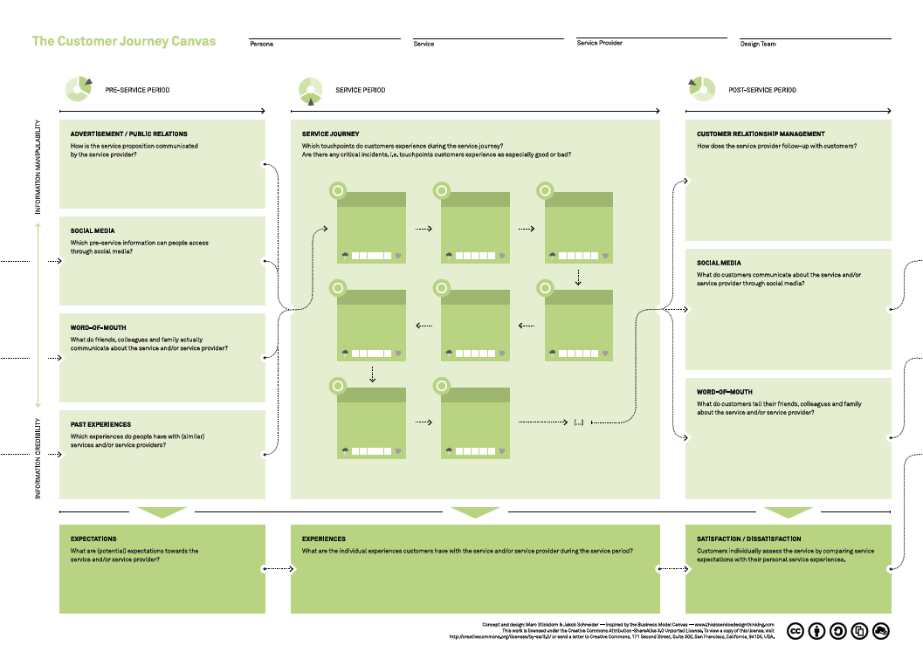
This is Service Design Thinking http://bit.ly/hkW9Ib

Slide 69
tell the story of the
existing journey
emotional highs, lows, moments of truth
Notes:
Are the touchpoint addressing motivations, answering questions, allaying concerns? Do they work for all personas?
Do they address unmet needs, both functional and experiential? Are there unstated needs that provide opportunity to innovate?
Are you speaking with the same tone, presenting the same personality, across all touchpoints?
Are they handoff gaps in the flow between stages that cause drop-offs or dissatisfaction?
Do the touchpoints differentiate your brand?

Slide 70
how can you reinvent their experiences?

Slide 71
brand experiences as story platform

Slide 72
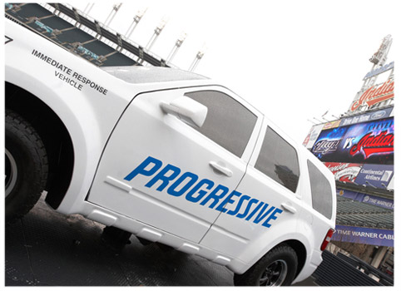
identified four experience environments to reinvent
accident site experience
getting an on-line quote experience
repair/claims settlement experience
share my driving habits experience

Slide 73
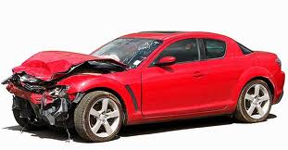
?
accident
claim
high anxiety

Slide 74

reduce fraud (disputed claims, high legal fees), shorter cycle time
accident
claim
taken care of, reassured
Notes:
Four Things a Service Business Must Get Right, HBR, Frances X Frei. http://bit.ly/r6TbZB
Progressive has shown up at the accident scene, processed the claim form and handed the insured a check -- all right at the crash site. Field adjusters are more productive. First notice of loss is processed more quickly. Cycle time is shorter, reducing exposure to litigation. Reduces exposure to litigation, its Loss Adjustment Expense, and the length of time its clients are forced to rent a car. Key to Progressive's ability to fund this service is the cost savings it ultimately yields. Normally insurance providers are subject to fraud, with criminals making claims for accidents that were staged or never happened. Because of these and other types of disputed claims, firms also incur high legal fees – which, combined with the other costs of fraud, add up to some $15 out of every $100 in insurance premiums across the industry. Since deploying its vans, Progressive has seen costs in both categories plummet. Sending a company representative to the scene pays for itself.

Slide 75
?
research
buy
Am I getting a good deal? Worry.
Notes:
Progressive offers another customer convenience that many competitors have so far shied away from: giving quotes from other providers alongside its own when a potential buyer inquires about the cost of insurance. It's not that Progressive is determined to go one better than rivals to win the business. In fact, Progressive's is the lowest quote only about half the time. What Progressive does believe is that its quote is the right one given the probability of that person's getting into an accident – a probability that the insurer is best in class at determining. If indeed its quote is spot-on, then allowing a competitor to insure the customer at a lower rate is doubly effective: It frees Progressive from a money-losing proposition while burdening its competitor with the unprofitable account. Thus a level of service that looks downright altruistic to the customer actually benefits the company. This is an example of leveraging operations into a value-added service.

Slide 76

frees Progressive from money-losing proposition, burdens competitor
research
buy
trust, delight, action
Notes:
Progressive offers another customer convenience that many competitors have so far shied away from: giving quotes from other providers alongside its own when a potential buyer inquires about the cost of insurance. It's not that Progressive is determined to go one better than rivals to win the business. In fact, Progressive's is the lowest quote only about half the time. What Progressive does believe is that its quote is the right one given the probability of that person's getting into an accident – a probability that the insurer is best in class at determining. If indeed its quote is spot-on, then allowing a competitor to insure the customer at a lower rate is doubly effective: It frees Progressive from a money-losing proposition while burdening its competitor with the unprofitable account. Thus a level of service that looks downright altruistic to the customer actually benefits the company. This is an example of leveraging operations into a value-added service.

Slide 77

focus on the lifetime experience…
use the cars for the first time
review their online billing for the first time
problem on the side of the road
refuel the car
get into an accident
Scott Griffith, CEO Zipcar
Notes:
Peter Talks Shop with Zipcar CEO Scott Griffith http://bit.ly/niPBTv
Almost every conceivable customer question, problem, and need has been anticipated and addressed, creating a seamless experience that appears — to the customer — effortless. This doesn't happen by accident; it happens by design. As is often the case in life, making something look easy is very difficult. We have a culture that we’ve tried to develop that, we hope, matches the brand that we deliver; and that’s all around self-service. The design is meant to be simple in nature, elegant, and self-service focused. It starts in the company’s culture and in the DNA of our brand. We’re very serious about keeping all of our user systems very simple, but we have a group internally that we call our product group [used to be product marketing, now called experience team].

Slide 78
?
research
sign up
but isn’t it cheaper to own my own car?
anxiety, uncertainty

Slide 79

research
sign up
worry alleviated, questions answered, reassured

Slide 80
?
parking ticket
pay
parking tickets
forgetful, unaware

Slide 81

parking ticket
pay
parking tickets
co-pilot (improved in-vehicle experience), reminded, aware, educational marketing, fun
Notes:
For example, we went through a major change to our billing system and to how we handle parking tickets that our members get. Our members get parking tickets all the time, and sometimes they just forget to pay them, and we have to find who was in the car; this was a big problem for a while. We resolved it through the kaizen technique. We used a kaizen on the co-pilot to see what we thought we could improve around the in-vehicle experience when people use our service. The result of another kaizen was a video that we now show. It’s an orientation video — it’s actually very funny — that’s on our web site for new members.

Slide 82
?
issue
leave
unhappy | annoyed | unsure

Slide 83

issue
complain
advocate
easy to complain
engender trust, delight

Slide 84


problem?
Notes:
when people engage in activities, it triggers emotion, which means they have experiences

Slide 85

opportunity to build relationships with customers
average increase of more than 10% in "Recommend to a Friend" scores
teachable moment
delight, more value out of card
xx
Notes:
American Express Reinvents Its Approach to Customer Service http://bit.ly/rbo1wZ
In late 2008 Jim Bush, head of worldwide service at American Express, led this charge to again reinvent the company’s approach to customer service. Bush rolled out a three-pillar enterprise strategy called Relationship Care to facilitate this transformation. “Moving forward we will create the integration of information so that we can serve the global citizen,” Bush says. “We want to be able to connect this flat world with technology and people under the common vision of delivering extraordinary care with the right margins. We have people who care. Our company is built on a heritage of service. It is something that permeates the company. It’s an incredible legacy to build from and to help support the growth of the company.”
When call-center agents hear that a customer has a specific need or situation, they'll quickly explain relevant card benefits and features -- essentially marketing the card by helping customers get more value out of it. American Express customers who receive such help show an average increase of more than 10% in "Recommend to a Friend" scores. This approach -- the right message at the right place and time -- will lessen marketers' dependence on out-of-context messages delivered through vehicles such as TV ads and direct mail, and bolster marketing's role within the customer experience ecosystem.

Slide 86

Mapping a Path to Better Health Care Jason Severs http://bit.ly/qRxUAg

Slide 87

Reframing Health, Hugh Dubberly http://bit.ly/pzWaDA

Slide 88
?
visit doctor
visit doctor
what should I be watching out for?
should I be concerned?
Notes:
So to inform this system, we need to move from the mental model of “sick patient” to “consumer of health products and services.”

Slide 89


visit doctor
monitor progress
visit doctor
empowered | reassured | listened to
Mapping a Path to Better Health Care Jason Severs http://bit.ly/qRxUAg
Notes:
Dr. Basch is currently working on a way for patients to become better at self-reporting by providing a vocabulary and protocol for self-reporting symptoms to the providers.

Slide 90


What does the redesigned journey look like?
http://slidesha.re/qMsHAc

Slide 91

think of the memories you want to evoke, then design for those memories
NOT what messages to communicate or what media should carry them
Notes:
Initial considerations for experiential engagement aren’t what messages to communicate or what media should carry them. Instead, think about what could make a great 'moment':
Where would it be?
What would it involve?
How would it be staged?
How would it be remembered?
How would it be retold?

Slide 92
Look for opportunities to relieve anxiety, anticipate needs, or surprise expectations
UK Design Council http://bit.ly/pCyI6g
Notes:
About: Experience Design by Ralph Ardill http://bit.ly/pCyI6g
How do you craft interactions, emotional cues, that allow customers to experience your brand?
Customer delight can be created consciously, systematically, and reliably
Reasons to increase delight
it increases loyalty - which means increased revenue
highly positive experiences generate highly positive word of mouth as well as increased loyalty
delight dissolves price resistance
Financial payoff
Proactively educating customers how to avoid problems not only makes them happy but also saves you the money that would have been spent solving their problems
creating delight generates word of mouth that reduces the need for marketing
cross-selling and up-selling create direct revenue as well as delight
five ways to increase delight
enhanced product value (major association found if they tailored reason for joining to drive the content of the welcome package sent to new members, a significant % were moved from satisfied to delighted)
enhanced transaction value
financial delighters
proactive communication
creating emotional connections

Slide 93
Ask yourself, what would make a magic moment?
magic
moment
Where would it be?
What would it involve?
How would it be staged?
How would it be remembered?
How would it be retold?

Slide 94
then, like any good story, ensure you design a clearly articulated beginning, middle, and end for the magic moment
beginning
middle
end
Notes:
For Pine and Gilmore, an experience is a memorable event. The first step toward making an experience memorable is to make it recognizable. The philosopher John Dewey wrote about this process in his classic essay “Having an Experience” (from Art as Experience). Most experiences are what Dewey called inchoate; they’re unfulfilled, with no closure. To elevate an experience from the daily stream of activity that we encounter, that experience needs to be fully formed with a clearly articulated beginning, middle and end.

Slide 95

Mapping out a wow experience
We understand what is and what is not important to the customer in that experience and then we design a ‘wow’ experience to improve it.
Richard Stollery, LEGO
http://bit.ly/nFhWf0
Notes:
LEGO improves customer loyalty, brick by brick http://bit.ly/nFhWf0

Slide 96
What are they thinking as they begin the interaction?
How will we measure the experience?
value
What does the customer value at this moment?
magic
plus
What adds to the experience? what could make it better?
minus
What subtracts from the experience?
<hear>
<see>
<touch>
<smell>
<taste>
What emotions do we want to evoke? How do we want them to feel?
What will people remember and talk about after the experience?

Slide 97

?
order
arrive
how long before it arrives? (uncertainty)
Notes:
boundaries, spaces between, are ripe for innovation

Slide 98

order
arrive
reassurance | fun

Slide 99
?
travel
input trips
I should get around to entering my trips…

Slide 100

nudged towards completeness, increase use
travel
input trips
surprised, delighted
Notes:
I've never talked about Dopplr properly. And so I shall do that now. Dopplr is basically a social network for frequent travellers. But you don't have to travel that frequently. And you don't have to be a Lounge junkie either. You simply add your trips to your page and your friends can see where you'll be and when. This leads to interesting little coincidences and global bump-in-to's. It's simpler than it sounds.
It shows all the traveling you did last year and wraps it up in a nice, funny, quirky, and sort of useful fashion.
And perhaps most importantly it makes me feel remiss for my incompleteness. It makes me feel like I need to put all my trips in there so that next year my document will be perfect. It flicks a really interesting psychological switch. Bloody nice work http://www.crackunit.com/2009/01/21/brilliant-dopplr-annual-report-another-pdf/

Slide 101

?
research
buy
I’d like it right away, is it available in the store?

Slide 102

research
buy
empowered | ready to act
Notes:
http://www.slideshare.net/jessmcmullin/leaving-flatland-crosschannel-customer-experience-design

Slide 103

welcome
first 90 days
overwhelmed, uncertain

Slide 104
enroll
onboard
empowered member
Beyond Chaotic Bombardment – Enhancing the Client Experience through Information Design http://bit.ly/q72U0l

Slide 105

?
sign up
insights
anxiety, overwhelmed

Slide 106

sign up
insights
hope, loyalty,
moments of self-realization that change behavior
Aaron Forth | Mint.com: Why Good User Experience and Design are Essential http://bit.ly/p0cmB7
Notes:
Get through barrier of sign-up to insights once they’re signed up…. 2-3 minutes… make assumptions & decisions for client. Emotion of personal finances has a large impact on how Mint approaches design. A few of the most important factors have included the name, the light color tones, and framing the topic of finance in the light of ‘hope’… money not source of frustration, but hope… achieving the things you want in life. About happiness, progress in life. College education. about where you’re heading, not where you are. Take away mundane feeling of personal finance. people are trying to get education….
Mint.com will also refer you to financial products that might be worthwhile. If, for instance, it knows your savings account pays only 1 percent interest, it will notify you if you can qualify for a better deal elsewhere. Mint.com earns a commission if you bite.
make assumption, if confident, make a call and put transaction into bucket… do the work for them… about not giving the users their way, make assumptions, decisions and not bothering the user and asking them to spend time & energy to put things in buckets over & over again.
Design for WOW moments. Add a couple of accounts. Show that are downloading transactions. Then wind up on Pie Chart (iconic symbol). People have moment of self-realization… can’t believe I exceed my beer budget again. Or I eat out so much (on twitter0> potential to change behaviors because people learn about themselves. Love to see comments cause rare moment get insight… “focus on providing insights”… once they have ability & knowledge can make decision to change if they want.
Coolest feature: With one click, turn your average spending into a monthly budget -- and then adjust amounts in each category until you find a balance you can live with.

Slide 107

insights
instant understanding while shopping of where at financially
Notes:
So if you aren’t sure if another restaurant meal will bust your budget, it will quickly show you how close you are to your monthly limit. Likewise, if you’re curious how much you spent on that cab ride you charged last week, you’ll find the exact amount in the merchant category.
If you’re at the store and aren’t sure how much room you have beneath your credit limit, you can send a short-code text message to Mint, and it will send you the balance information for that account.

Slide 108

Winning the Zero Moment of Truth, Google http://bit.ly/oGcJPC

Slide 109


Slide 110


Slide 111


Slide 112


become aware
research

Slide 113


Snake and ladders, desires and needs http://bit.ly/oMIzxO
Notes:
Snakes and Ladders is an analogy to a kids board game where the goal of the game is to get from start to finish. But along the route there are ladders, jumping you ahead in the game, and snakes, setting you back in the game.
Using this analogy is meant to symbolize that even though there is some form of linearity in every sales/purchase process, it is not constant. Sometimes you jump far ahead, but suddenly something affects the process and you are taken back again to a previous state. Mark Caris and Alex Barclay, Stephan Philips
Snake and ladders, desires and needs http://bit.ly/oMIzxO

Slide 114
write the new journey
orchestrate a series of clues designed to provoke positive emotional reactions and lever persona to next stage of journey

Slide 115
what’s the impact of experience?

Slide 116


Slide 117
elder
50% reduction in infections
71% drop in daily prescription-drug costs
26% lower turnover in nurses’ aides
Talking with Bill Thomas http://bit.ly/pNyyFC

Slide 118
complainant
person with a story, wanting to move on with their life
contract
instructed analysts to call the people seeking disability benefits and interview them for a half-hour to learn more about them…
Leslie McMillan, Industrial Alliance
80% drop in spending on independent medical evaluations
settlement time fell from 8 weeks to 4
boosted revenue by marketing higher-value disability management products
claims ending in litigation dropped from 12% to 7%
employee satisfaction shot up

Slide 119

economics is (now) about emotion and psychology Robert Shiller, Professor of Economics, Yale University

Slide 120

Branding in 2009, Part 2 Loyalty Helge Tenno http://bit.ly/qAm2Dg
Notes:
loyalty evolves from great experiences and emotional connections that happen over time... the stories people remember
- Action Based Loyalty. This is measuring the activity of repeat purchase. But! Action Based Loyalty has got little to do with loyalty, because it is only concerned with the action itself, not the drivers or incentives behind it. As Lou Carbone has said “Just because I fly AIRLINE doesn’t mean I love them, I hate AIRLINE”. This is unfortunately the loyalty most often tracked and used as a success metrics by brands.
- Rational loyalty. A much used technique where price, accessibility or other rational characteristics are used to create repeat purchase. An example from Norway is a retail store lowering their prices on fruits and vegetables by 20%. Very effective. But the weakness of Rational Based Loyalty is that it doesn’t stick, it is very unfaithful. You have it only as long as you are the best in the category where you aim to build your loyalty. As soon as you stop investing in it, or someone delivers an improved service, the loyalty shifts.
- Affective Loyalty. This is the loyalty created by an emotional brand. By building an idea, a story around the brand and communicating this in a way that the customers finds relevant and want to engage with – in order to become participants. Affective Loyalty sticks, it lasts longer than any other form of loyalty, and it creates a unique position the brand can establish an ownership of:
“Affective loyalty is the strongest form of loyalty and will be the most difficult form to compete against.” – Brand Building in Norwegian, Samuelsen, Peretz and Olsen

Slide 121

Branding in 2009, Part 2 Loyalty Helge Tenno http://bit.ly/qAm2Dg

Slide 122

Branding in 2009, Part 2 Loyalty Helge Tenno http://bit.ly/qAm2Dg
Notes:
Branding in 2009, Part 2 Loyalty Helge Tenno http://bit.ly/qAm2Dg
Customer loyalty in e-commerce: an exploration of its antecedents and consequences Srini S. Srinivasana,*, Rolph Andersona, Kishore Ponnavolub
According to the study “Customer Loyalty in e-Commerce” from Drexel and McKinsey the most important aspects of e-loyalty is trust and personality. It’s not low prices, usability or a coupon. No, it’s a brands that they can count on, that helps them feel secure and informed. That goes out of its way to offer extra service. And it’s a brand with an identifiable and unique personality one can relate to.

Slide 123
From products
to people
(experience driven)
managing the customer relationship (CRM)
designing interactions
customer
value
customer value
building emotional bonds
Idris Mootee Customer Experience Design Talk http://slidesha.re/oyiguc

Slide 124
Both outside-in
& inside-out
(brand experiences)
inside-
out
outside-in
deep understanding of customer
purpose, vision, brand
building emotional bonds

Slide 125
wrap

Slide 126
ask provocative
questions

Slide 127
Who is your hero?
Do you have a strong situation & plot (what is the customer experience you want to deliver)?
Have you set the stage?
Are emotional cues for the emotions you want to invoke in place?
Have you staged the interactions?
Do you have a clear understanding of the value you create for the customer and for your organization?

Slide 128
journey mapping is a journey each map you create
enlarges your reality
enlarges the reality of your organization (calling its belief systems into question)
infuses itself into the myths that shape your organization’s understanding of the world

Slide 129

keep in touch
@joyce_hostyn
jhostyn@opentext.com (email)
www.joycehostyn.com/blog (blog)
knowledge.opentext.com/go/adoption (Adoption Community)

